Slide 1
Physics 3 – Oct 24, 2019
P3 Challenge –
Describe the conditions needed for two waves to experience maximum constructive interference.
Hmk Review: Use 4 white boards or the class boards to share answers for 15-18.

Slide 2
Objectives/Agenda/Assignment
Objective:
4.3 Wave characteristics
Agenda:
Boundaries
Energy and intensity
Polarization
Assignment
p171 #19-24

Slide 3
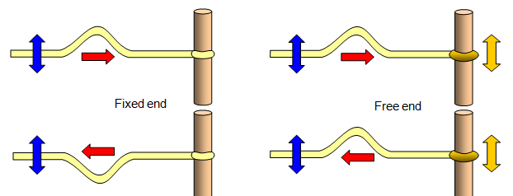
Reflection from a boundary
When a wave encounters an end point, the wave gets reflected and the direction of wave propagation changes.
At a fixed end, the wave gets inverted. A free end will maintain the wave phase.
https://www.youtube.com/watch?v=1PsGZq5sLrw

Slide 4
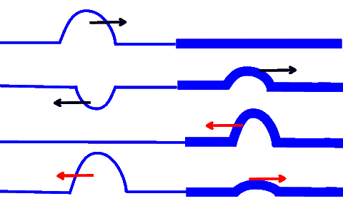
Changing mediums
When a wave encounters a change of medium, there is a transmitted wave and a reflected wave.
Changing to a thicker or stiffer medium is like encountering a fixed boundary. Reflected wave is inverted.
Changing to a thinner or weaker medium is like encountering a free boundary. Reflected wave is not inverted.
Transmitted wave is never inverted.
https://www.youtube.com/watch?v=eLDIJvTEBhg
https://www.youtube.com/watch?v=dNmlNzrMF2k

Slide 5
Energy in a wave
Recall that the total energy in a mass on a spring system is represented by the amount of potential energy stored in the spring at maximum compression. E_{P} = ½ kx²
The energy of a wave similarly corresponds to the square of the maximum displacement of the medium, better known as the amplitude. $E∝A^{2}$

Slide 6
Intensity
The function of a wave is to transfer energy from one location to another.
The power of a wave is the rate at which is can do this. P = E/t
The intensity of a wave is its power incident on an area A.
$I=\frac{P}{A}$ Unit = W/m² often written as P = IA
Intensity is also proportional to amplitude squared.

Slide 7
Intensity
Because a point source creates a spherical wavefront and the surface area of a sphere is 4πr², the intensity of a point source at a given distance x from the source is $I=\frac{P}{4πx^{2}}$
This is called the inverse square law for wave intensity. $Iα\frac{1}{x^{2}}$
Intensity is also proportional to A² because Energy is.

Slide 8
Sample Problems
A stone dropped in still water creates circular ripples that move away from the point of impact, Z. The height of the ripple at point P is 2.8 cm and at point Q is 1.5 cm. Calculate the ratio of the energy carried by the wave at P to that at Q.
The power radiated by the Sun is 3.9 x 10²⁶ W. The distance between the sun and the Earth is 1.5 x 10¹¹ m. a) Calculate the intensity of the Sun’s radiation at the upper atmosphere of the Earth. On a clear summer day 70% of this amount arrives at the surface of Earth. b) Calculate how much energy is received by an area of 0.50 m² in 1 hour.

Slide 9
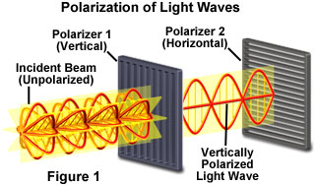
Polarization
Natural light consists of all possible orientations of the plane of oscillation for the electric field of the EMR.
Polaroid paper or lenses or plastic allows only one direction of oscillation to pass. The result is polarized light with only one direction of oscillation.
Polarized light has ½ the intensity of Unpolarized light.
Play with Polar papers.

Slide 10
Malus’s Law
If a second polarizer is placed in front of already polarized light, only the portion of first polarized light that is the direction of the second polarizer will pass through.
The amount of light intensity passing through is given by Malus’s Law $I=I_{o}\cos^{2}θ$ Where I₀ is the incident intensity, I is the resulting intensity and θ is the angle between the two planes of polarization.

Slide 11
Problems
If light with an intensity of 20.0 W/m² is passed through a polarizer which is oriented at and angle of 25.0 degrees to the vertical, and then through a second polarizer oriented at an angle of 40.0 degrees to the vertical, what is the transmitted intensity?
You decide to use two polarizers to control the intensity of a stage light because your diva is complaining about the lights in his eyes. You place the first piece of polarize paper vertically. At what angle do you need to place the second piece of paper to reduce the light intensity by 15%?

Slide 12
Exit slip and homework
Exit Slip – At what distance from a 100 W light bulb will you have an intensity of 18.0 W/m2?
What’s due? (homework for a homework check next class)
p171 #19-24
What’s next? (What to read to prepare for the next class.
Read IB 4.4, p172 – 181

